Slide 1
Reversing Corruption
in Seagate HDD Translators,
The Naked Trill Data Recovery Project
By MrDe4d &
Allison Marie Naaktgeboren
Notes:
Allison
Thank for you coming to see us right after lunch. If you fall into a post lunch coma, I won’t take it personally.
We’ll yammer at you in a hopefully entertaining manner before taking some questions at the end.
Afterwards, we’ll hang out a bit in the hallway.

Slide 2
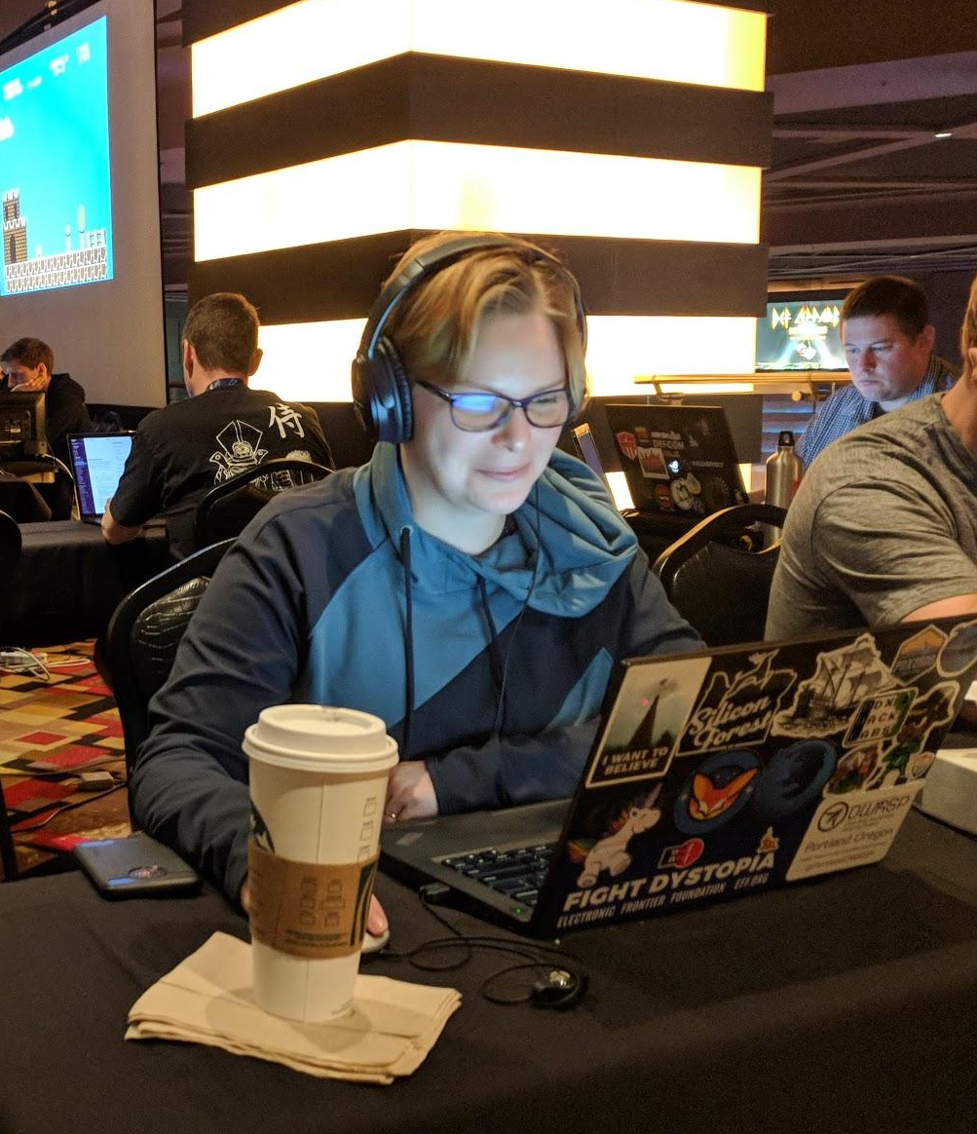
Allison Marie Naaktgeboren
There’s more than one Allison Naaktgeboren?!
Yes, really. Please yell at the right one
‘Naaktgeboren’ means ‘born naked’“...may not be obvious at first unless you're Dutch.” - PEP20
Old Code Monkey
Previously at Signal Sciences, Mozilla, FactSet, Amazon, Cisco, RI Biorobotics Laboratory, Coding with Kids
Community
CTF Captain, cofounder QQQa
CTF minion, Samurai
Algorithms Lead, WWC PDX
OWASP
Mentor, PDXWiT & First Robotics
Carnegie Mellon University, BS in CS
“Differentiable and Piecewise Gaits for Snake Robots”
“Design of a Modular Snake Robot”
“Relative Localization in Colony Robots”
Notes:
Allison
I’m one of several Allison Naaktgeborens. AFAIK I’m the only software developer.I currently build high level defensive software. So many, many abstraction layers above the hardware
I haven’t touched hardware since college, where I learned that cutting edge robotics research is the easy part of paper publishing. It left _that_ much of mark. I am not a subject matter expert, so please feel free to tell me I’m wrong afterwards.
CMU: When I was your age, the only ctf was kgb’s ctfws!

Slide 3
MrDe4d
Primary researcher; named the project
Talks at DEF CON, HushCon, Teardown, & Arch Reactor Hackerspace in STL
Co-founded Revenant Data
Independent research: SMR technology, AFH manipulation in Seagates, MicroJOGs concepts and control
Self taught except for:
Scott Moulton’s data recovery training
BSidesPDX CTF data recovery/forensics challenge with Wireglitch

Slide 4
High Minded Reasons to Care about HDD Repair
Right to Know
Lack of standards reduces quality (and costs you money..)
Right to Repair
Ownership is not a timeshare! (United States Magnuson-Moss Warranty Act)
Right to a less hazardous environment
HDDs aren’t compostable, and there are a lot of them
Manufacturing materials are bad for humans, bad for the environment
10 secrets the data recovery industry doesn’t want you to know (#7 will shock you!)
Notes:
Nik
Right to know: An example would be to take a look at the actual ATA standards issued by the INCITS T13 committee. You will find the majority of those ATA cmds are still vendor specific, and that standards outside of I/O protocols are severely lacking in HDDs. Moreover, the terminal debug interface that Allison and I have centered our tools around, HAS ZERO STANDARDS and is entirely up to the manufacturers!
Not just the vendors enjoy the veil of secrecy at your expense; lack of public standards reduces the quality of devices in the market, esp at consumer lvl. High cost generated bc of the amount of research I have to do in order to save your data, bc none of this info is readily available. Plus, large companies enjoy profiting from the secrecy (data recovery often treated like magic).
Cobalt may be used as platter coating
Right to repair: when the drive fails, you’d like your data back. Manufacturers want you to use their data recovery services, and their services only!
Topic sentence: there are several reasons to care about hdd repair even if you don’t necessarily have one in need of repair right now.

Slide 5
It’ll Never Happen to Me….
50.71% of the HDDs that come through Revenant Data are Seagates
8.16% have some type of translator corruption
Seagate
Started shipping drives in 1980 [Wikipedia]
Shipped its 250,000,000th hard drive in 1999[Gnomes, 2000]
Shipped F3 architecture, modern translators, 2008
If 100,000,000 drives active → ~ 8,160,000 cases of translator corruption
Professional repair can be expensive
on the order of ~700-3,000 $ when it happens
It is not unheard of for large data recovery companies to charge upward of 8,000 $ for a single case
Notes:
Allison
About 50% of the drives that cross MrDe4d’s desk are Seagates, of those, just over 8% display translator corruption. It doesn’t sound like very much, but math is funny.
In the first 20 years Seagate shipped 250 million drives, and they kept shipping
F3 modern architecture shows up in 2008, so just over 10 years, let’s be conservative with our back of the bar napkin math & say there are 100 million drives currently active. That would mean just over 8 million cases.
When it happens to you, you’ll find out that getting your bits back can be quite pricey. Between 700-3,000 for translator corruption, and prices north of 8,000 aren’t unheard of in general.
It was just such a case that started this journey.

Slide 6

The Original Quest
Seemingly Undamaged HDD & A Really Bad Day™
Corrupted translator suspected
no access to user data or partial access (Spildit, 2013)[6]
Is it the “short points problem”?
Short the read points, gain terminal access, force a regen of translator...success!
Actually, what other errors can we fix?
Current focus, translators
Type of recovery that you can DIY at home
Notes:
Mr.De4d
<FOCUS ON THE STORY OF HOW WE STARTED WORKING TOGETHER>
--Pretty much every time I get this case type in, I start kvetching immediately bc I know it has the potential to be a time sink. All the more frustrating bc once I am past the “timing issues”, it is quite a simple fix! Not to mention it isn’t too terribly difficult to diagnose.
Topic sentence: these types of data recovery cases suck! A lot of repetitive tasks….Due to these cases being fairly common, and costing several hundred dollars per, our goal is to have users at home be able to fix this issue themselves.
notes to self: focus more on how the issue is something that can be fixed at home by *you*, the repetitive timing issues which are scritpable (how I told Allison that I needed a script for a few repetitive tasks).
<This is where I start introducing how this project came to be, after the “Corrupted translator” bullet>
--Wouldn’t it be nice if the timing aspect could be automated? (enter, Allison, the code master!!)
--Software engineer confirmed with “Why spend an hour fixing it the hard way when you can con a software engineer into spending hours writing software to fix it?” ;)
Although, we did spend hours and hours together trying to recreate the problem :)
--Thought it could be fixed with a script….little did we know!

Slide 7
Signs Translator may be Corrupted
The hard drive boots¹ but...ERROR! ERROR! ERROR! ERROR! ERROR!
LED: 000000CC FAddr: 0024A051, stuck in busy error (Spildit, 2013)
LED:000000CC FAddr:0024A7E5, short the read points (Spildit, 2016)
SIM Errors 100*-1008
SIM Error 1009
Notes:
Mr.De4d (take note on timing here...we can expand or condense this slide more easily to make/lessen time)
error conditions should make more sense to audience after background
May get a screenshot of actual terminal output to put here in lieu of descriptions CHRIS
Verbally mention other SIM errors which indicate translator corruption: SIM Error 203F / SIM Error 2040 / SIM Error 2044 / SIM Error 3005
System file 17a is the G-List
click of death could be other things in addition to the translator

Slide 8
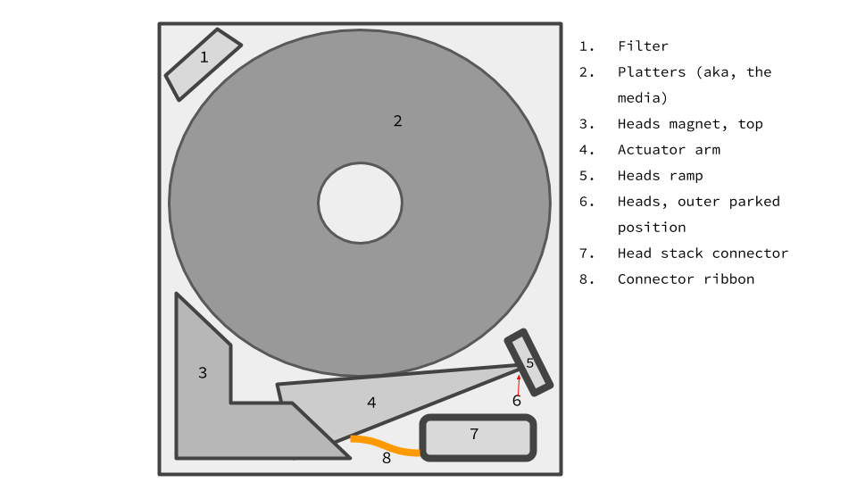
Anatomy of a HDD
Notes:
Mr.De4d
Before we get too deep in the weeds, it will be helpful to go into some background info on HDDs, starting with anatomy.
So what’s inside a hard drive? Start with most important parts first! Platters (2), heads (6), head stack connector (7)
Focus on heads, ramp, and platters which are most important to translator/accessing data, i.e. the head stack connector is in contact with the PCB, and the read channels that we short are part of that.
In the case of Moses & Pharoah, head location doesnt match up to the firmware version.
Why does that matter for Naked Trill and the translator?

Slide 9
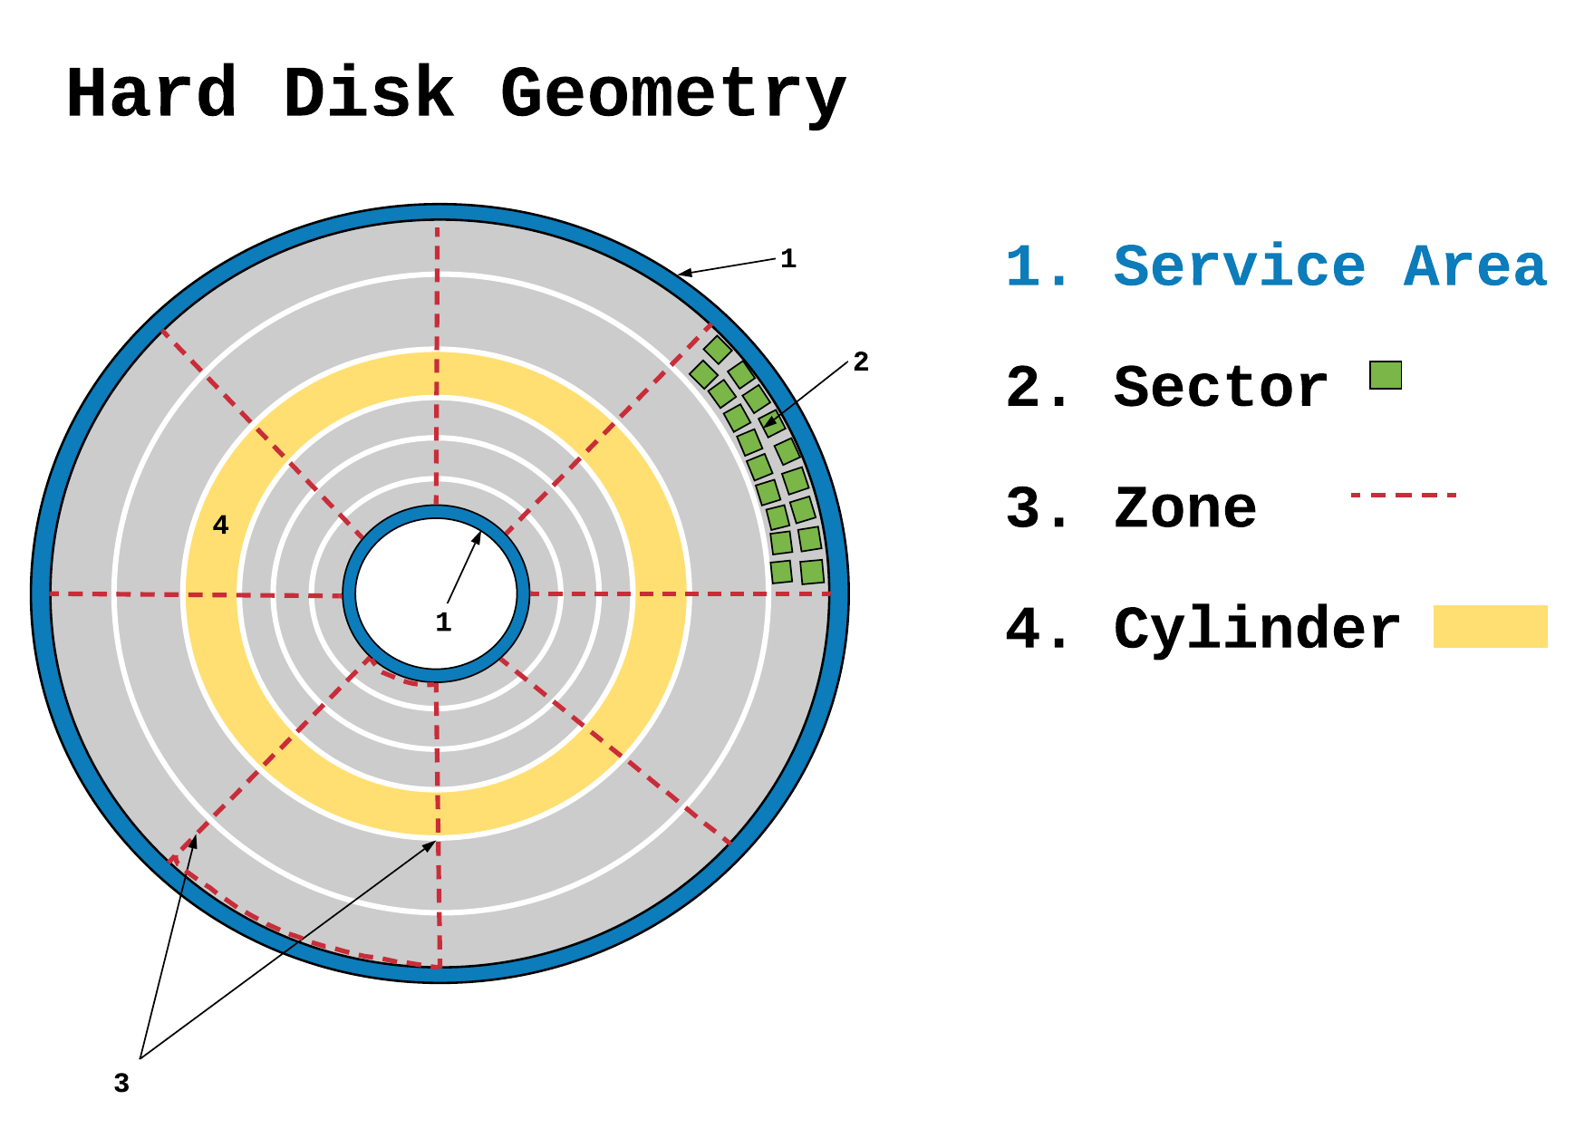
Notes:
Mr.De4d
System data vs User data Mention CHS, LBA. mention diff between sector and block: sector is physical location of where data can be stored, block is logical data.
Cylinder: concentrically expanding rings around entire disk. If the HDD has more than one platter the cylinder goes through all of them.
Sector: 512B block (520B when factoring in ECC) within each track
Zone: wedges of data including multiple sections of cylinders (or more precisely, truncated circular sectors- no, I am not a mathematician, I only wish I was that cool!)
The system files (firmware) live on the SA (blue rings, or tracks) of the disks.
**It is important to note the SA regions in relation to this project bc I have to listen for the heads leaving the parking position in order to know the approx time to short the read pins and send Ctrl+Z**

Slide 10
Firmware’s Usual Suspects
Translator: maps LBA (Logical Block Addresses) to CHS (Cylinder Head Sector) & vice versa
Uses defect lists to skip or remap bad sectors
Without a working translator, HDD can’t find the data
If you wanted to hide some bits from the file system, this isn’t a half-bad place to put it
Primary Defect List
Defects found at factory
Non-Resident Grown Defect List
Second pass for primary defects performed at factory (Seagate-specific)
Grown Defect List
Defects accumulated over time
Potentially ~2GB of “spare” space/sectors exists in the the G-List
There are others: overlays, head adaptives, SMART etc, that are not relevant to this talk
Notes:
Allison
Hardware is scary, let’s talk about software instead.
The translator is one of the most important bits in firmware. LBA stands for logical block address. Anything called ‘logical’ is always an abstraction AKA something we made up. CHS is a physical location on the platter. We need to get from one to the other. We also don’t want vital bits in bad sections. Otherwise data is lost. The translator maps from LBAs to CHS and back again. It’s the final link in the chain to where your bits are in the physical world.
How does it accomplish that? Well, like all good data structures or famous hackers, it has a posse of helper data structures, specifically defect lists. While working with them, the seem to act a great deal like arrays.
Broadly speaking there are two types of defects. Those that are bad from the start, and those that develop over time.
Primary Defects
Defects found at factory. Not expected to change. You’re either borked at creation or aren’t. Called a self scan test in Seagate lingo.
Called primary defects, found on the primary defect list , often called the P-list
In Segates, starting with the F3 architecture 7200.12 and beyond, I’m told, there is a second list Non Resident G-list, a second pass at the factory
Grown Defects
These accumulate over time, rust spots,
This list is expected to grow over time, but it’s not really expected to shrink
Is usually allocated a large amount of space compared to P-lists
If you really wanted a host os to not know about you data, hiding it in ‘bad’ sectors might be an interesting, but that’s an entirely different conversation. not that we would encourage such shenanigans.
2GB of “spare” space math: each sector is 512 bytes, multiplied by ~4000 which is the average size of a G-List, then divided by the size of one MB of 1024, is 2GB. (512*4000/1024)

Slide 11
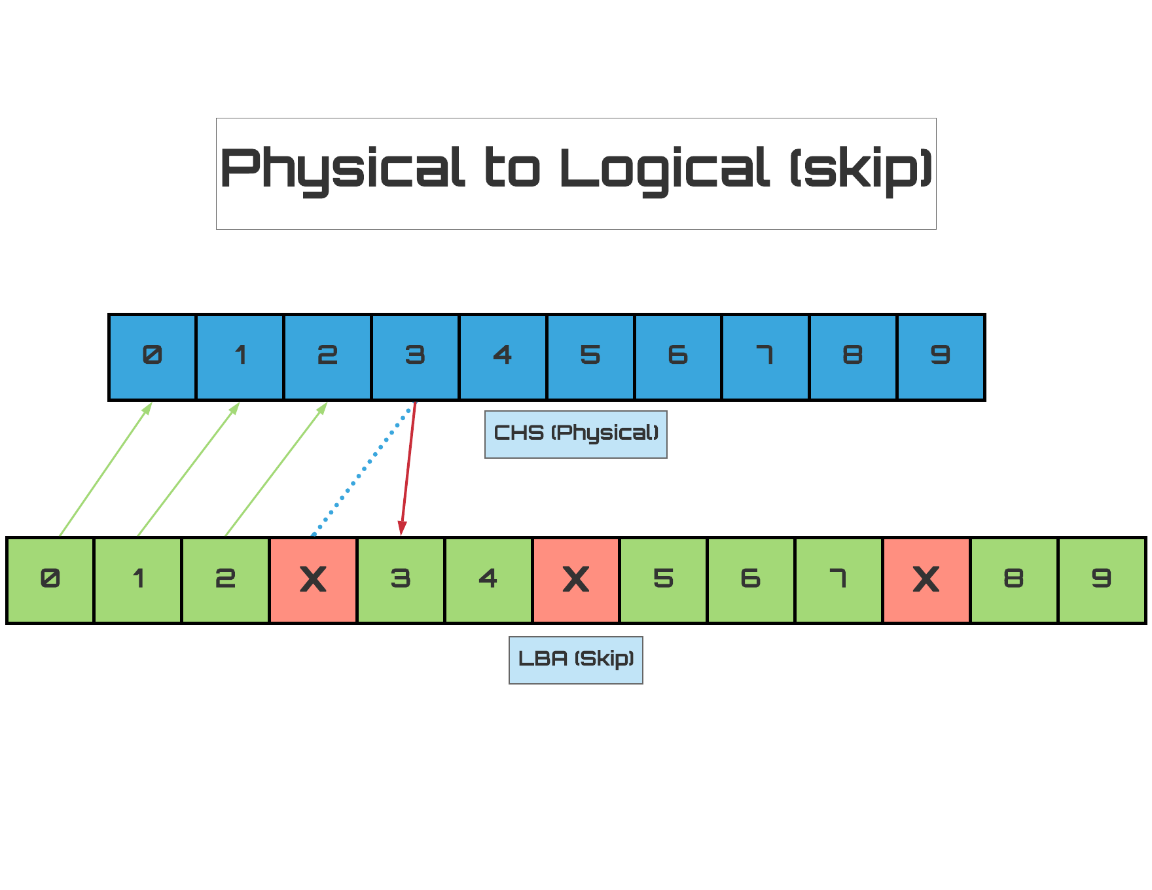
Notes:
Allison
How do the lists manage the defects? There are two techniques , skip and remap.
Of the two, skip is the most intuitive. When a sector is bad, the head is directed to ‘skip’ over it. This is pretty fast, but has limitations.
Primary lists tend to be skip lists

Slide 12
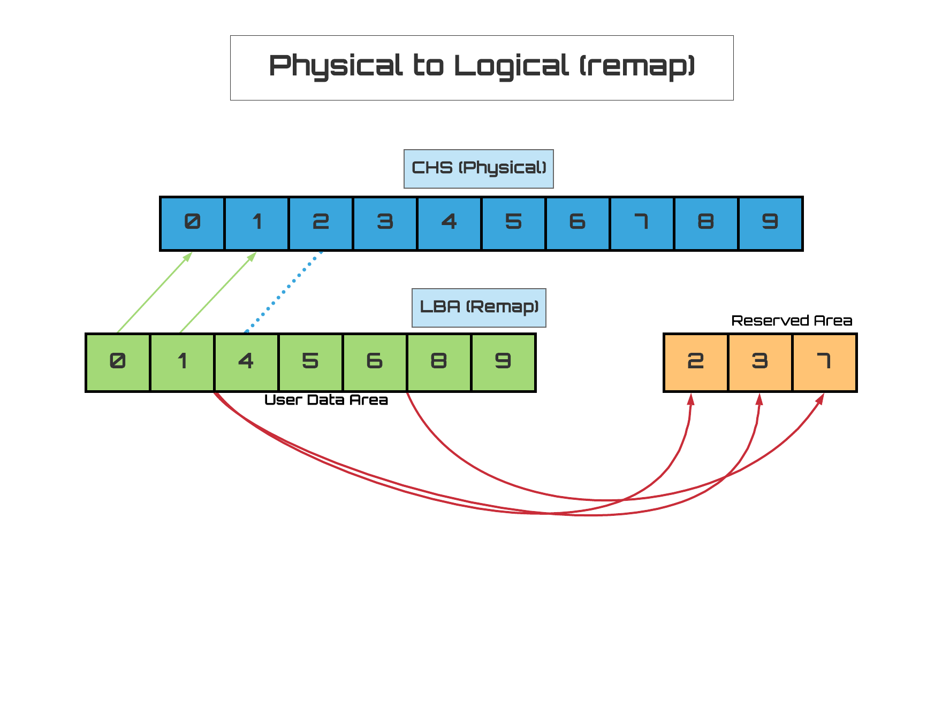
Notes:
Allison
The other list type is the remap, where the heads are directed away from the user area to reserved memory to read sectors.
These are slower, since the heads have to move to an area far away. The more often it has to do this, the slower the drive is.
However, they have the advantage of being dynamic, which is why G-lists, tend to use them.

Slide 13
Our Foolproof Plan Cannot Possibly Fail
Controlled corruption of a translator on a target drive
finite space is allocated for g-list, overfill it!
Run through a manual fix
Model it with a program
Test it on unsuspecting members of hackerspace
???
Profit!
Notes:
Allison
So we studied the problem and we came up with this brilliant plan worthy of a bond villian.
Who’s written software before?!
Nilk
Who’s played with proprietary hardware before?
Allison
You know where this is going..

Slide 14
If we knew what we were doing, it wouldn't be called research...
Notes:
Allison
Unsurprisingly, we ran into some issues.

Slide 15
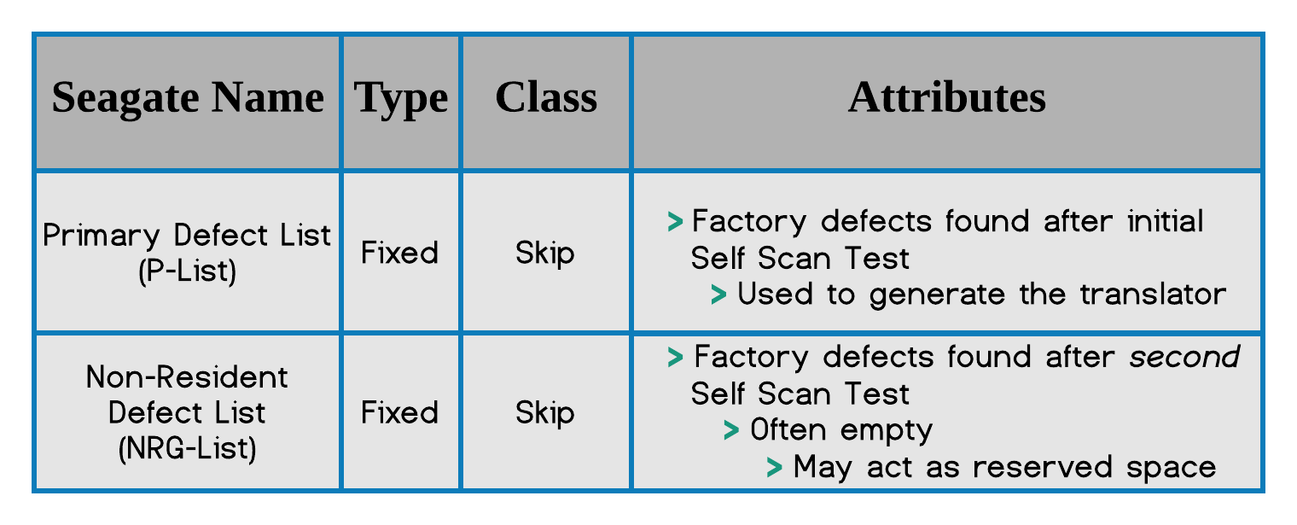
Translator Defect Lists: Primary
Notes:
Allison
When we started splunking in the hardware, we were expecting to find 3 lists, P-list, G-list, and the NRG list.
We found two of those off the bat. So far so good.

Slide 16
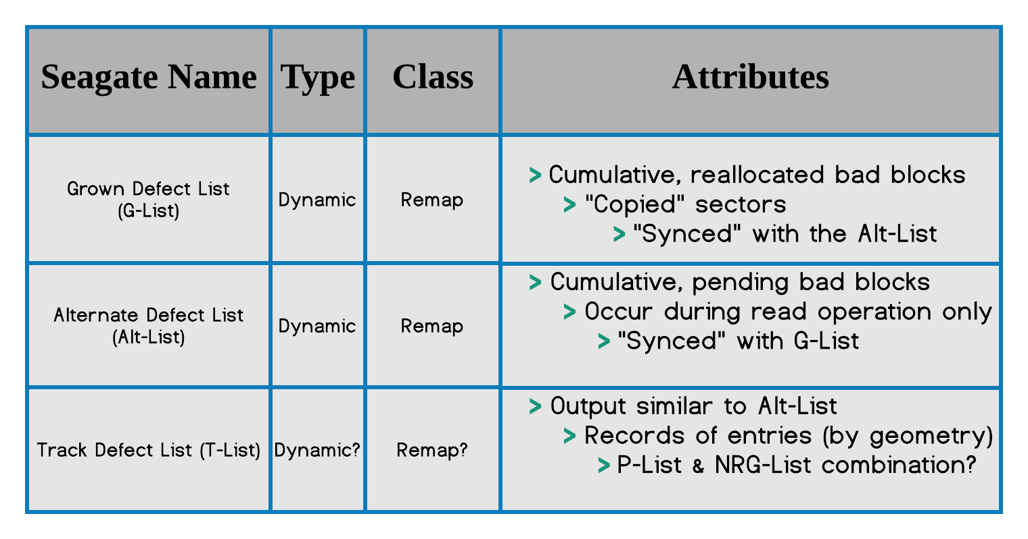
Translator Defect Lists: Grown
Notes:
Allison Problem 1
That warm fuzzy feeling didn’t last.
Instead of one G-list, we found at least 3, the G-list we expected, and the Alt-List & T-list we were not.
Problem #1 become figuring out which of these lists we should corrupt, which ended up being mostly trial & error through some manual testing.
We eventually settled on the eponymous G-list.
Alt-List vs G-List note: Translation regarding G-list: “pending” sectors aka pending reallocation sectors, occur during read operations only. A sector is found to be erroneous via ECC which acts as a checksum, during a read operation, and is then pending reallocation. The pending sector is only reallocated if on the next write attempt on that sector, the ECC still doesn’t match. Keep in mind, data on these pending sectors, once they are reallocated, is copied to the spare sector
‘Sync’ed’ - sort of

Slide 17
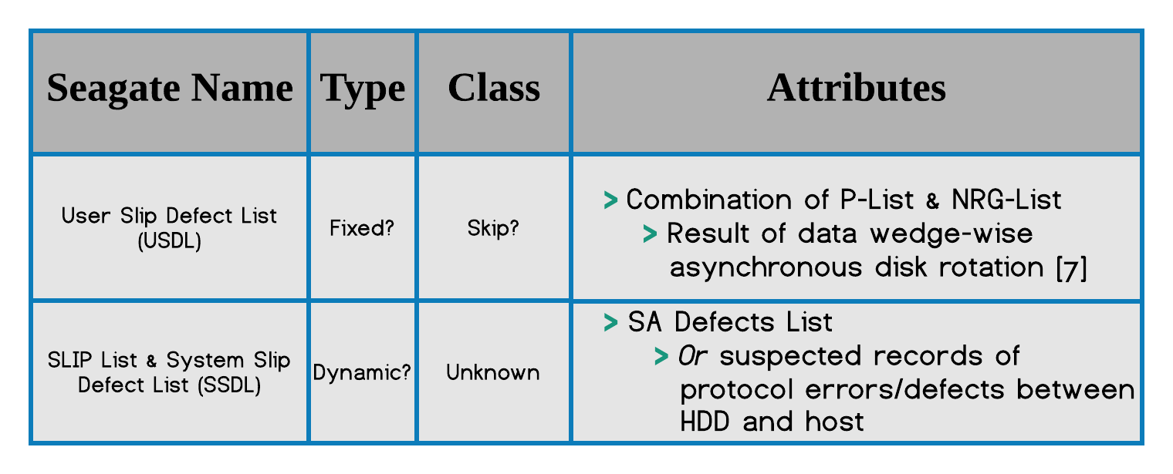
Translator Lists: SLIP-Lists
Notes:
Allison
We also found these folks at the party, called SLIP lists, bringing it to a total of 7 lists. They aren’t relevant to this talk nad we don’t know a lot about them, but we wanted to note they’re there.
Notes:
MrDe4d note that the aerial density of Service Area is different than user area (SA uses UBA or Utility Block Addressing)
Note that USDL and Slip List may in fact be two different lists. Note that our definitions of USDL came from Fzakbar’s analysis of Samsung modules.
USDL may be stored geometrically different than other lists. Though it is comprised of two static, primary, skip lists, it may be a way to provide additional reserved space for factory defects or defects that should be skipped but occur after factory.
SSDL: was only able to view after sending “check T-List” cmd, suggesting relation to the T-List, thus relation to the P and NRG Lists.

Slide 18
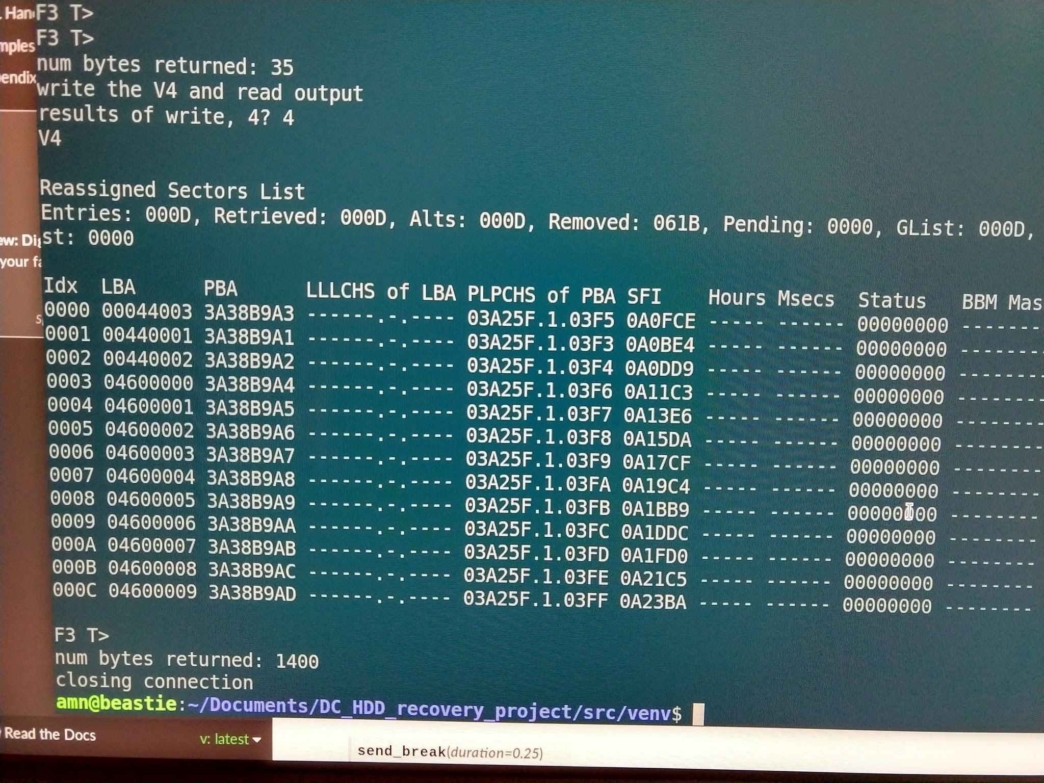
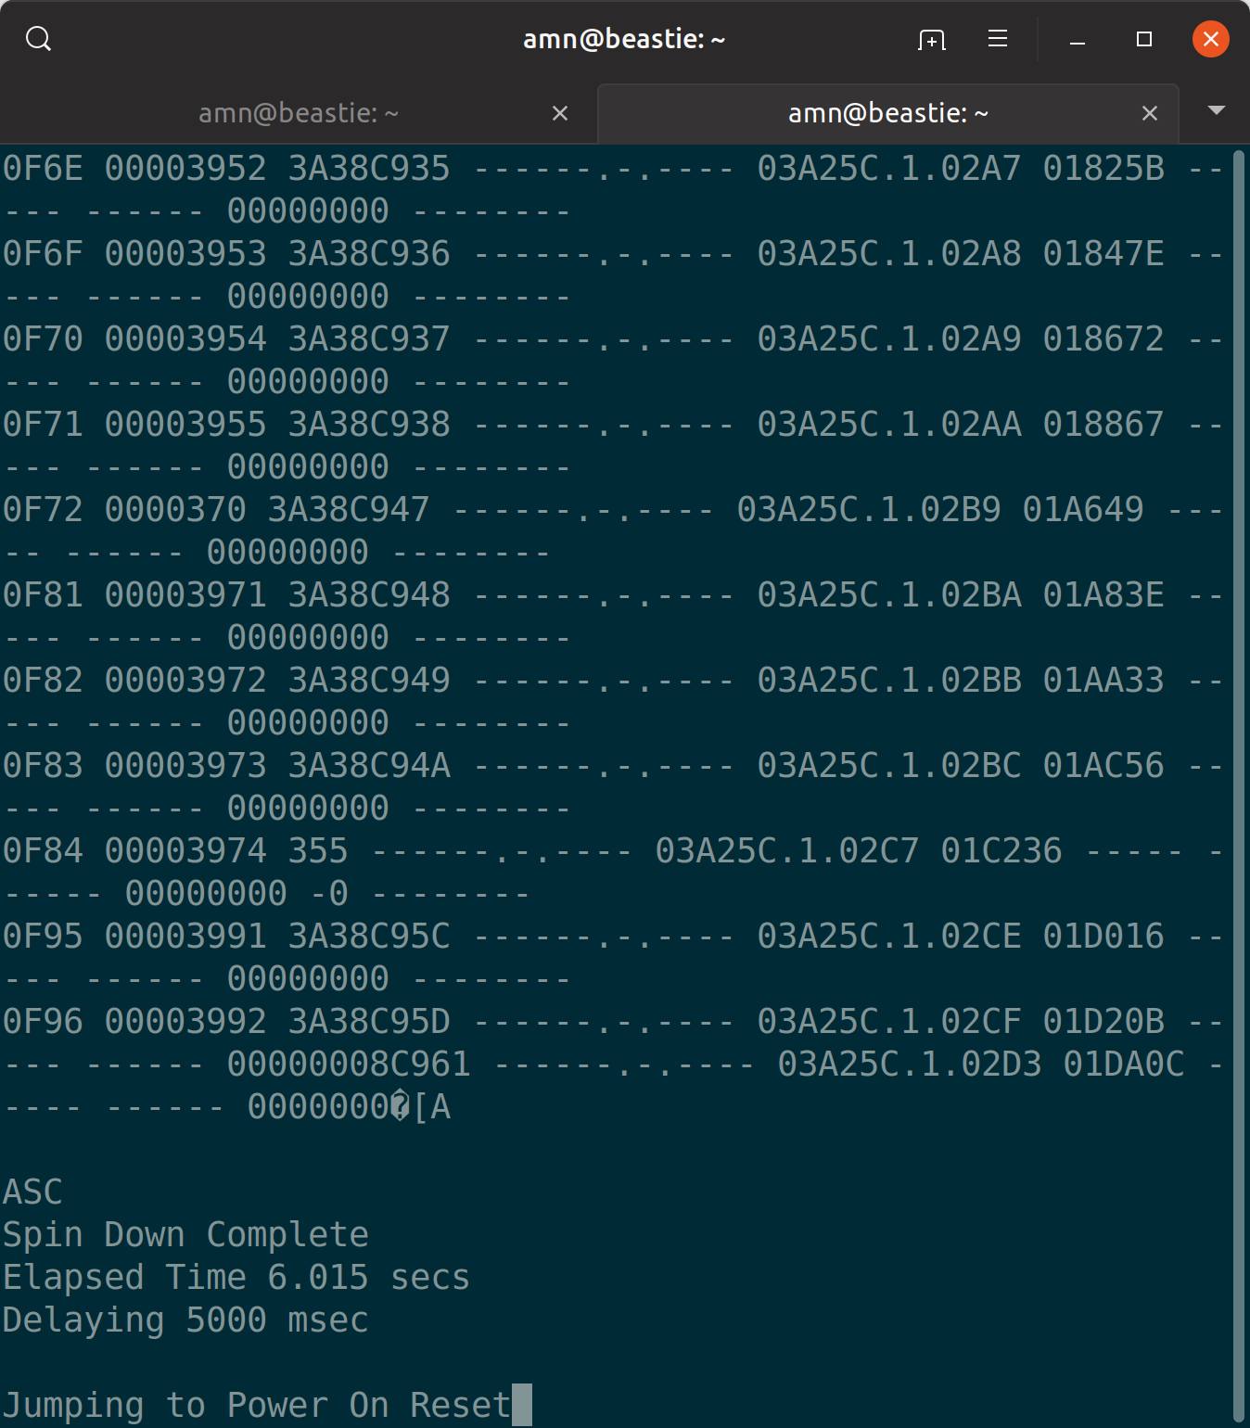
Sanity Checking-- LHS: Script RHS: Screen
Notes:
Allison Problem 2
So once we had chosen a list, we figured overfilling the list would be trivial, add about 2000 entries and it should fall right over.
Initially Mr.De4d added about ~3400 entries by hand. I lasted about 30 before deciding pyserial was the lesser of two evils.
Even after scripting it, we’d add 6,000+ it seemed like it just wouldn’t corrupt.
It did eventually dawn on me that maybe the translator was smarter than we were giving it credit for.
We had been adding entries sequentially, maybe it was just lumping them together.
I added randomization and that worked eventually. The list turned out to have a lot more space than we had been expecting.
Currently it takes about 4,000-4,500 to corrupt the firmware.
We had issues keeping the drive up for the long windows of time. It’s not uncommon for a drive with a full-ish remap list to be really slow, like 10 minutes slow.
If you look carefully, you can see the drive just ...spinning down on the Screen side.
On the other is a check of the state of the g-list, with not as many entries as I was expecting to find that iteration.

Slide 19
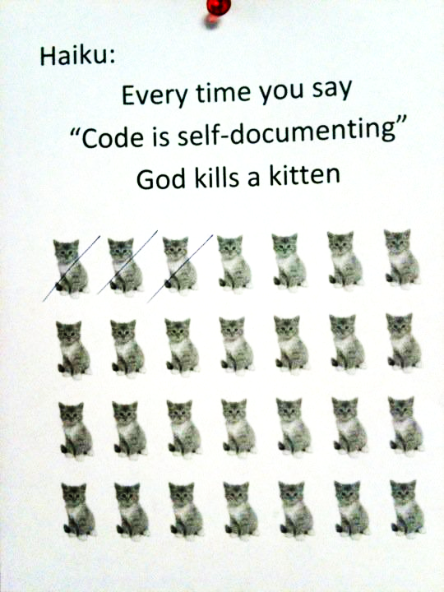
Firmware is Weird
Quick! What do these do?
F3 6> E2
F3 T> i4,1,22
Notes:
Allison
Problem #3, #4
If you’ve never messed with firmware, it’s not the easiest thing. Let’s look at an example or two.
<click>
What’s this one do? F3 6> E2 == create a user defined batch file, number 0x0
<click>
How about? F3 T>i4,1,22 == erases the G-list
<click>
If anyone ever says this to you, kindly refer them to the Seagate firmware.
I don’t have a slide for it, but we also ran into issues with behavior differences between seagate firmware. AP63, the apple version, does not produce error signals and messages we were expecting. So, did it not work, or is it just not going to output if there is success?

Slide 20
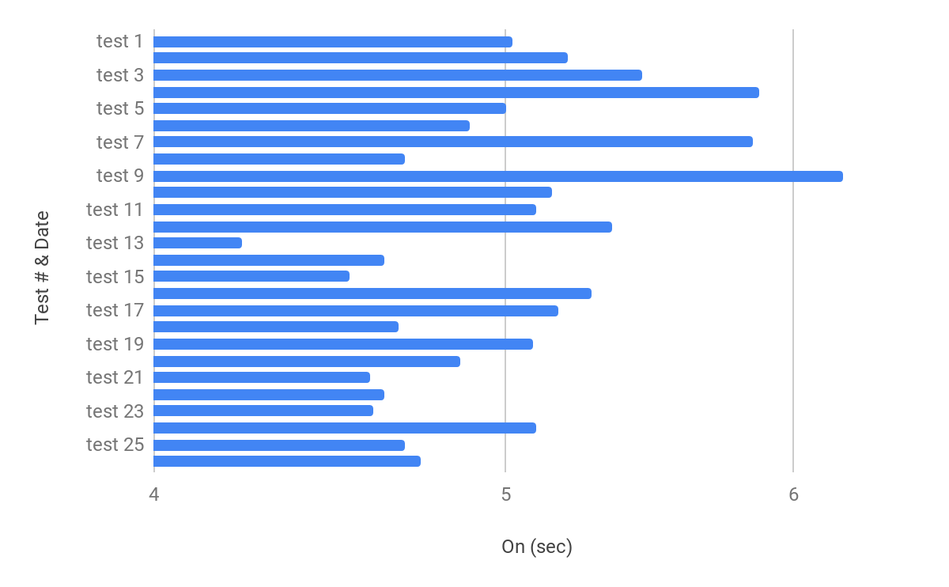
A Window Both Narrow and Wide
Notes:
Nik
Problem #5
Mention what we are attempting to time and how that plays into this manual fix.
Results of the timing tests during attempts at manual fix ‘
Time from power on to heads leaving ramp and seeking the service area to read, the translator
Notes- maybe mention that this is all from a single drive, highly variable.

Slide 21
The (mis)Adventure So Far...
Surprises
There were more lists in firmware than anticipated
which one(s) should we target?
Differences in firmware behavior between versions
AP63 vs CC38 vs CC45 vs JC4A
Translator proved smarter than anticipated
G-List has more space than anticipated
Firmware code is really difficult to grok
Hurdles
Problems between seat & workbench
Human errors
Software engineer can’t hardware
Hardware engineer can’t software
Significant Timing Variance
Cmd output could take ~1 sec to 6 min
Pyserial was less reliable than anticipated
PySerial on Windows not recommended
Notes:
Allison - Surprises
Okay that last one should not have been a surprise
Nik - hurdles

Slide 22
Where we are now..
We can reverse corruption if the diagnostic mode is available
Ex SIM Error 1009
We can consistently corrupt the target drives
But…. we haven’t yet been able to reproduce the original target solution under observation
Notes:
Allison
We can consistently corrupt our target drives, those in the Moose & Pharaoh families.
We can also consistently reverse some forms of corruption, liek SIM error 1009 if the diagnostic mode is available.
All that is great, but we still haven’t managed to reproduce the original target solution, and I’m not sure we will be able to based on the timing data.

Slide 23
WIP++
Not all hackers are coders and not all coders are hackers
Exclusion of non-coders makes my hacker spirit sad
Written to help those that don’t code understand
Code deliberately simplistic and procedural
I’d like to enable everyone to learn
Python is the lingua franca of security, C is very useful
GPL v3 : Sharing is Caring
Notes:
Allison
Before we point you to the code, I have a few things to say. The development philiosophy for this project is rahter different from the usual.
Hacking existed before computers, and I hold that not all hackers are coders. There are many highly technical people in data recovery that can’t code and I wanted to make this accessible to them. I did test it on a few patients souls to verify that.
Our goal is sharing information and keeping it in the open, so we have a GPL v3 license.
Purist developers, avert thine eyes! The scripts flaunt DRY, is heavily commented, and very procedural. It’s written in python because that seems to be the poison of choice and because it’s easier for noncoders to read than say, C.
Please file bugs with all that in mind.

Slide 24
What You’ll Need to DIY
USB to TTL Adapter with a FTDI Chip FT232RL ($3-$15)
Access to the TX RX & GND pins
Power adapter (or TTL with shared-host power)
Code
https://github.com/anaaktge/naked-trill-hdd-recovery
PySerial module
[ENCOURAGED] install Screen
[STRONGLY ENCOURAGED]
Test hard drives identical to the “patient”
Match the model number
Drive family of Pharaoh, Moose (ID via debug mode, model# OK)
Firmware versions
This type of corruption may not occur in Dell specific fw version JC4A
Apple fw has its own set of rules too
Notes:
MrDe4d need to de-wordify this slide...could potentially just say “see me after the talk in the HHV and I will show you what we used”
May mention right off the bat that even I was not extremely comfortable using the DIY set up, as I am spoiled with proprietary tools and their (expensive) ease of use.
Bought our gear on amazon
may need to remove case
Firmware versions notes: Apple fw seeks and read SA at different times rendering the short read pins/issue terminal cmd solution ineffective (thank Frasier)
Dell fw JC** seemed impervious to G-List overfill (careful, thar be a rabbit hole here…)
Back up the service area SA (especially that pesky system file 03/P-List) lest you lose all your precious data...but really, just don’t do this on a drive you care about!
In some cases you can read and write system files in some ST drives with protocols like X-Modem via terminal interface (F3>T /r028 will read system file 28, the translator) and then you can save it.

Slide 25
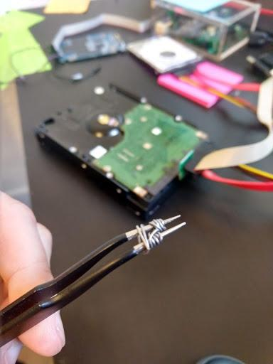
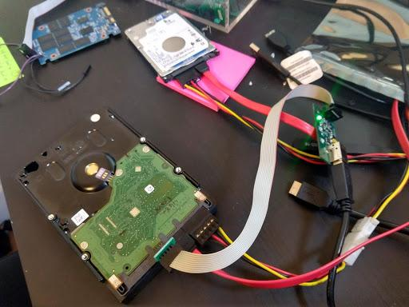
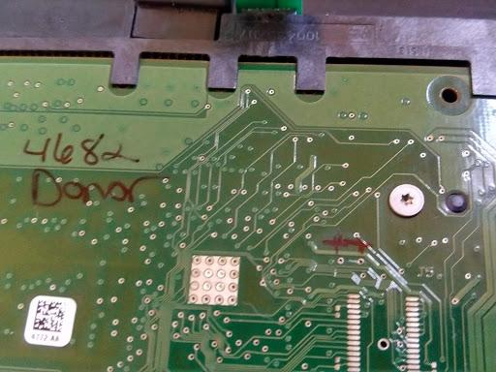
Our Setup
read points
Notes:
Mr.De4d

Slide 26
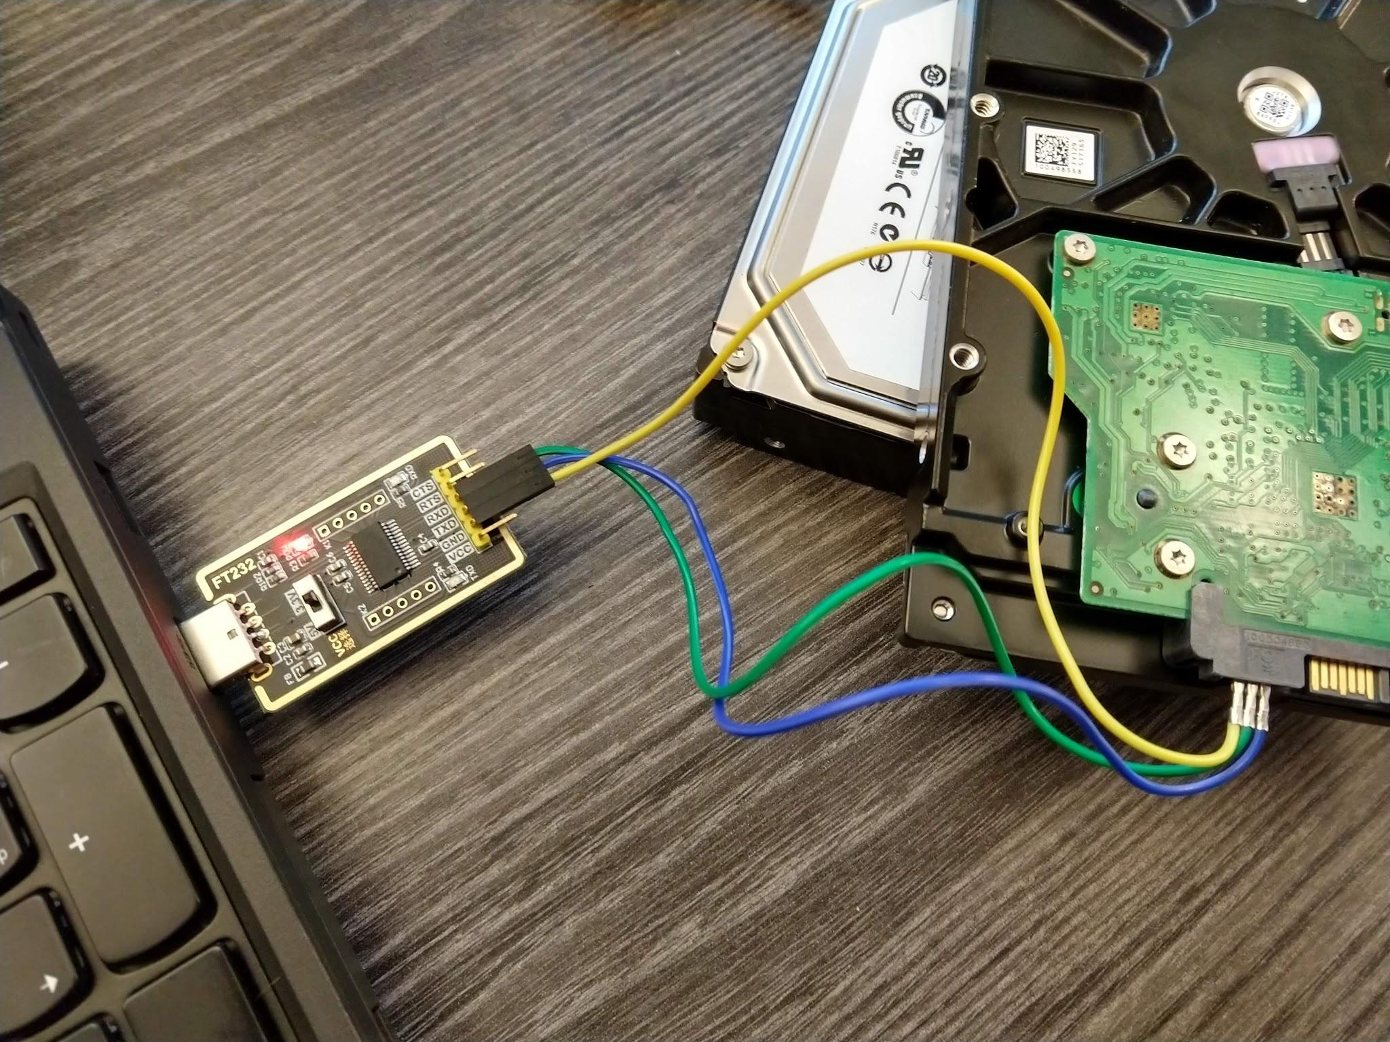
Connection Layout
Pin Set-Up
RX on TTL matches the TX on the HDD
GND is 3rd to the left from SATA with PCB facing up
[power connector not shown]
Notes:
Mr.De4d
TX pin is closest to SATA, RX is right next to TX
Feel free to take another pot shot at my (Allison’s) inability to wire

Slide 27
Please Be Very Careful!
Not everything done in firmware can be undone.
Notes:
MrDe4d
Disclaimer time! Backup the SA!! You can permanently lose data without the backup of the P-List, along with sys files like 28 (the translator itself) and 93 (the ID info for the drive/….or possibly the packt xml file.

Slide 28
You Got This!
Get software installed and in order
chmod is your friend
Hook up connectors
double check your connectors
Determine what port your os assigned
ex) COM1 on windows, ttyusb0 on linux
linux:
we used dmesg to check
Screen to vet a manual connection
Run scripts with required arguments in specified order.RTFM.
listen carefully in case of short pins
Notes:
Allison + Nik

Slide 29
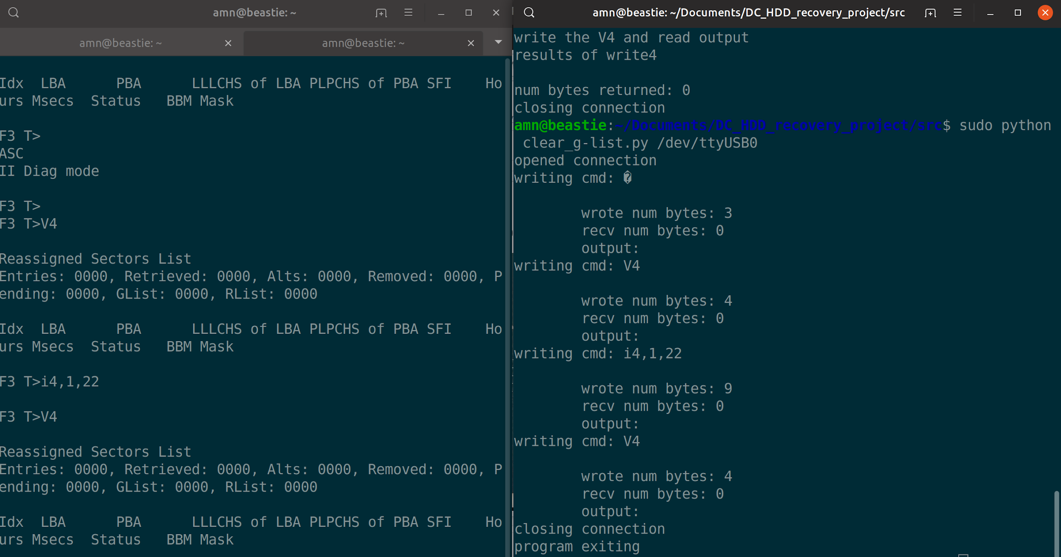
Like a G(list) Six
Notes:
Allison
Remember how I mentioned that remaps are really slow, and that as the G-list gets full-ish, things really slow down? That’s going to happen pretty early on, and it’ll look like this. You’ll see the script returning 0 bytes when output is expected. Don’t panic it might eventually show up, but the receive will not be waiting for it. One side is screen and you can see the output does arrive from the add command, just a full tea break later.

Slide 30
What’s Next?
Continued Work
Solve the original problem without shorting if possible
Configure translator rebuild based on lists you specify
Expand to include other Seagate families and HDD manufacturers
Implement via ATA commands
Help Wanted
Long term goal: open source data recovery suite
Feature requests
Code contributions
Help testing
Open knowledge about the firmware
Notes:
Shared
Allison- Continued Work,
MrDe4d- Help Wanted. Since DC27 we have been approached by others in the DR community. Please do not be shy about contributing.
Nik- Remember, the original quest was for me to find a way to automate the shorting of the read pins and issuing of the Ctrl+Z. We still haven’t done that, though we did find other tools we could build that are a bit less complicated and timing sensitive.

Slide 31
Acknowledgements & Thanks
Justin Hibbits (firmware),
Wireglitch (data recovery),
Mawlee (social engineer for pricing),
Fraser Corrance (data recovery expert),
Fzabkar (data recovery researcher),
Spritesmods aka Jeroen Domburg (firmware researcher, prior research),
Spildit (data recovery researcher, HDDOracle founder),
Securelyfitz & px (cfp feedback)
Notes:
Nik - special thanks to Spildit

Slide 32
Bibliography
https://github.com/ActualMrDe4d/Naked-Trill-Data-Recovery-Project/blob/master/README.md
OR: kik.to/y7
repo:
https://github.com/anaaktge/naked-trill-hdd-recovery
Notes:
Mr.De4d
Allison - reminder to focus on questions, comments & scheming after in the hallway :)

